Slide 1

Dr. B R Ambedkar National Institute of Technology, Jalandhar
Department of Information Technology
TOPIC MODELLING ON DARK WEB FORUMS
Minor Project Evaluation Phase - II
Presented by:
  Vidur Dua, 23124119
  Shivansh Dutta, 23124102
  Karman Singh, 22124056
  Vaibhav Kanda, 23124113
Supervisor : Dr. Jaspal Kaur Saini (Assistant Professor – Dept. of IT)

Slide 2
TABLE OF CONTENTS
1. Introduction
2. Literature Review
3. Problem Statement
4. Objectives
5 . System Architecture (Diagram)
6 . Methodology
7. Basic LDA Implementation (Ansar1 Dataset)
8. Issues Observed (Basic LDA Limitations)
9. Proposed Improvements
10. Progress Till Now
11. Future Scope
12. References

Slide 3
INTRODUCTION
Dark web forums contain discussions related to: cybercrime, drugs, zero-day exploits, financial fraud, ransomware, illegal marketplaces, etc.
Manual analysis is difficult due to large volumes and high noise.
Topic Modelling helps extract hidden themes.
LDA (Latent Dirichlet Allocation) is widely used but struggles with noisy and short dark-web posts.
This project focuses on:
      - Implementing Basic LDA,
  - Identifying its limitations,
- Proposing enhancements for future implementation.

Slide 4
LITERATURE REVIEW
Author(Year) | Journal | Dataset | Methodology | Drawback
Scanlon & Gerber (2014) [2] | Security Informatics | Ansar1 Dark Web Forum; ~29K posts, 192 labeled for recruitment detection | Text preprocessing + TF-IDF features; trained ML classifiers (Naive Bayes, Logistic Regression, SVM). Best performance with SVM (AUC ≈ 0.89) for detecting cyber-recruitment activity. | Very small labeled portion; English-only posts; simple Bag-of-Words features; limited ability to capture deeper context or multilingual text.
Saini & Bansal (2019) [3] | Cybernetics & Systems | 4 jihadist forums (Ansar1, IslamicAwakening, Gawaher, IslamicNetwork); 313 labeled posts | Classical ML pipeline using SVM, Random Forest, MaxEnt, Tree-based models; evaluated with precision, recall, F-score. Focused on detecting illegal weapon procurement conversations. | Dataset small and binary in nature; mostly English content; ignores other extremist activities; doesn’t handle multilingual, noisy real-world dark-web text.
Geeganage et al. (2024) [1] | Semantic-LDA | Benchmark corpora for topic modelling (general-purpose datasets) | Introduced Semantic-LDA, which incorporates semantic relationships and word–concept mappings to improve topic coherence. It addresses LDA’s limitations by producing more meaningful and interpretable topics, especially when words have multiple meanings. | Requires external semantic resources (ontologies/knowledge bases); higher computational cost; not tested on noisy multilingual dark-web data, so performance on such text remains unknown.

Slide 5
PROBLEM STATEMENT
Problem Statement
Dark-web forum posts are short, noisy, unstructured, and multilingual (Somali, Arabic, English). Such content contains slang, code words, and ideological language, making automated analysis challenging.
Traditional LDA struggles on this type of data due to:
- Overlapping or unclear topics
- Low topic coherence
- Noisy / irrelevant high-frequency keywords
- No semantic understanding (words treated independently)
- Poor handling of multilingual content, especially Arabic
Need for Improvement
- A more robust pipeline is required with:
- Stronger preprocessing and normalization
- Multilingual handling (Arabic → English translation)
- Improved semantic representation to extract clear, meaningful, and interpretable topics from dark-web discussions.

Slide 6
OBJECTIVES
Objective 1: Extract primary discussion topics using Basic LDA.
Objective 2: Identify limitations and noise in extracted topics.
Objective 3: Research and list advanced methods to improve LDA.
Objective 4: Understand multilingual aspects (English + Arabic content).
Objective 5: Prepare a roadmap for implementing improved topic modelling.

Slide 7
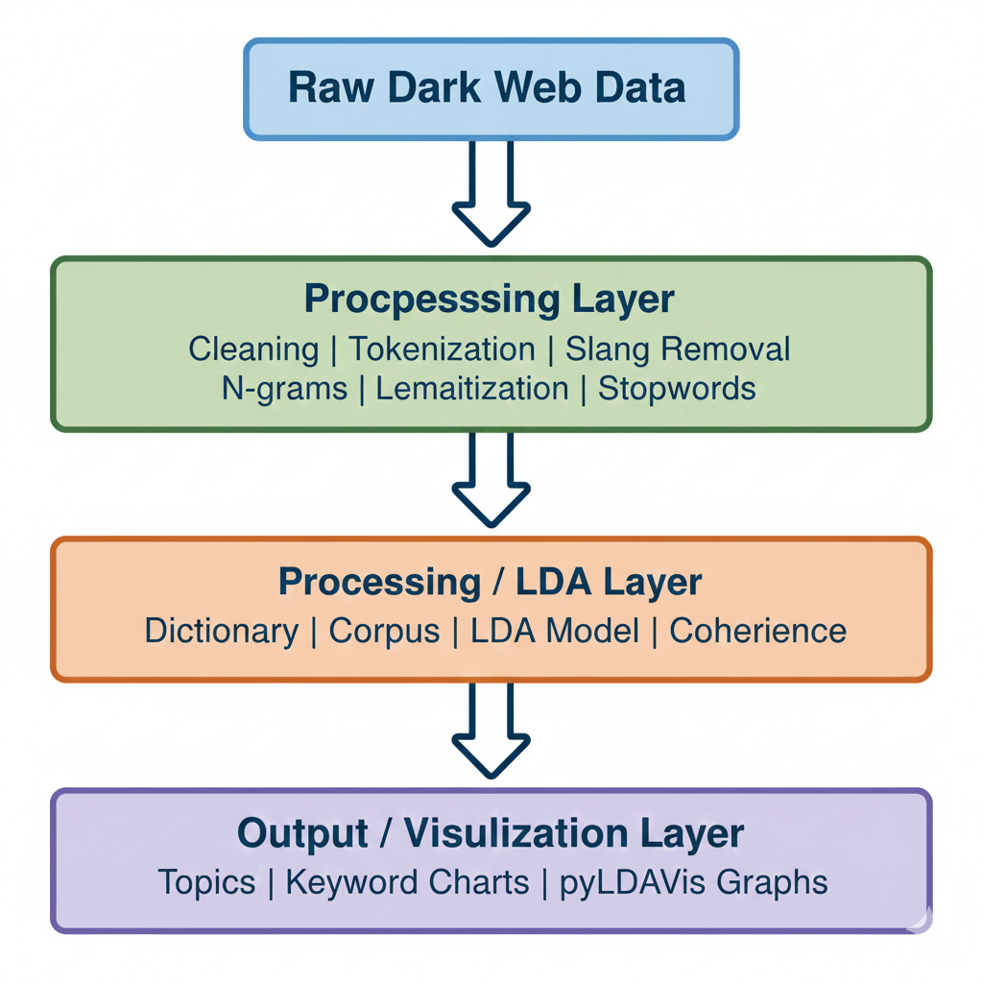
System Architecture Diagram

Slide 8
METHODOLOGY
Stage 1: Data Collection
Dataset taken from Dark Web Project Portal, University of Arizona
Link: https://www.azsecure-data.org
Used the 7 Dark Web Forum Dataset
Multilingual (Somali/Arabic/English), noisy, unstructured text
Organized files, cleaned formatting, created metadata
Stage 2: Data Pre-processing
Language detection (Somali / Arabic / English)
Noise removal: URLs, symbols, HTML, numbers
Text normalization: lowercasing, punctuation cleanup
Tokenization + lemmatization using spaCy
Custom stopwords: English + Somali + Arabic
Basic translation for Arabic posts (if required)
Goal: Convert raw dark-web text into clean, analysable tokens.

Slide 9
Stage 3: Baseline Topic Modelling (Basic LDA)
Built Dictionary + Bag-of-Words corpus
Applied TF–IDF filtering
Trained LDA with topic numbers: 10
Evaluated using Coherence Score
Observations:
- Coherence ≈ 0.41–0.45 (low)
- Heavy keyword overlap
- Topics not clearly separated
Purpose: Establish a baseline for topic extraction.
Stage 4: Topic Interpretation & Visualization
Manual inspection of topic keywords
Identified major themes:
      - Propaganda
  - Militant activity
  - Security/political discussions
  - Ideological content
Used pyLDAvis for topic visualization
Generated word clouds and topic-frequency plots

Slide 10
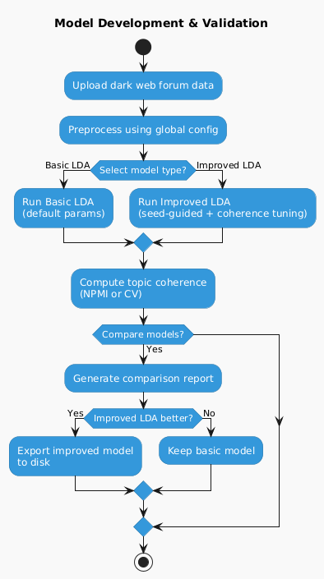
Fig. 1 Dark Web Topic Modelling Workflow

Slide 11
Basic LDA Implementation
(Ansar1 Dataset)
LDA Input
Dataset: Ansar1 dark-web forum dump
Documents processed: ~28,800
Vocabulary size: ~6,500 cleaned tokens
Training passes: 20
Iterations: 400
Topic numbers tested: 10
Outputs Observed
Best coherence score: ~0.41–0.45 (low for short/noisy text)
Keyword overlap: High (same words repeating in many topics)
Language noise: Somali terms dominating multiple topics
Frequent high-weight words: “somalia”, “somali”, “attack”, “group”, “security”, “military”, “al-shabaab”
Sample Topics Detected
Militant group discussions (Al-Shabaab, Somalia)
Regional conflicts & security updates
Political commentary
Propaganda / ideological narratives

Slide 12
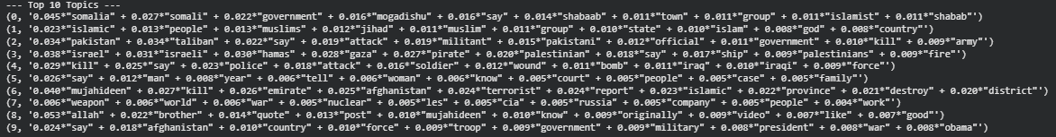
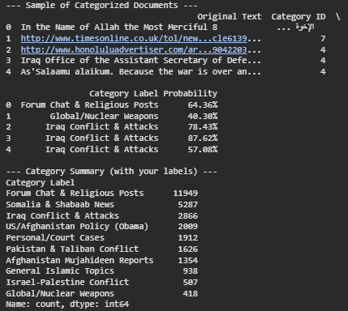
Basic LDA Implementation
(Ansar1 Dataset)
LDA Topic Modelling Results
Top 10 Extracted Topics
Custom Topic Labels Used
Somalia & Shabaab News
Gen eral Islamic Topics
Pakistan & Taliban Conflict
Israel–Palestine Conflict
Iraq Conflict & Attacks
Personal / Court Cases
Afghanistan Mujahideen Reports
Global / Nuclear Weapons
Forum Chat & Religious Posts
US / Afghanistan Policy (Obama)
Sample Document Classification
Topic Distribution Across 28,866 Posts

Slide 13
Issues Observed (Basic LDA Limitations)
Technical Shortcomings
Low coherence (<0.50)
High topic overlap
Inability to capture short-message context
No support for Arabic text (approx. 15-20% of data ignored)
Dark Web–Specific Challenges
Slang: cc dump, logs, fullz, botshop
Obfuscation: deliberate misspellings
Domain-specific stopwords needed

Slide 14
Proposed Improvements
1. Advanced NLP Preprocessing
- Custom dark-web stopwords
- Slang dictionary building
- Eliminating repetitive marketplace templates
2. N-Gram Modelling
- Bigram and trigram detection
- Capture phrases like:
“zero-day exploit”, “credit card dumps”, “malware kit”
3. Hyperparameter Tuning
- Optimize:
  - Number of topics
  - Alpha
  - Beta
  - Passes & iterations
- Select best model based on coherence score

Slide 15
Proposed Improvements
4. TF-IDF Based Vocabulary Filtering
- Remove useless frequent words
- Remove extremely rare terms
5. Using Mallet LDA
- Known to produce higher coherence values
6. Document Length Normalization
- Solve problems of short dark web posts
7. Multilingual Topic Modelling
- Dark web has Arabic posts related to extremist ideology, fraud, drug marketplaces
- Proposed addition:
  - Arabic → English translation before LDA
  - Use fastText / HuggingFace for language detection
  - Multilingual embeddings for better clustering

Slide 16
Progress Till Now
✔ Completed
Dataset collected
Preprocessing implemented
Basic LDA model trained
Coherence evaluated
Topic clusters generated
Improvement strategies researched
Multilingual analysis assessed
❗ Pending
Implement improved LDA pipeline
Arabic processing pipeline
Hyperparameter tuning
Model comparison & final evaluation

Slide 17
Future Scope
Full implementation of improved LDA
Complete multilingual pipeline
Real-time dashboard for threat intelligence
Track topic drift over time
Implement deep-learning models:
  BERTopic (expected +25% quality)
  LDA2Vec
  Top2Vec
Add sentiment & intent detection to identify:
  Threat levels
  Harmful intents (e.g., hiring hackers, buying exploits)

Slide 18
REFERENCES
[1] University of Arizona, Dark Web Project Portal.
https://www.azsecure-data.org/
[2] A. Abbasi, H. Chen, A. Salem, “Sentiment Analysis in Multiple Languages: Feature Selection for Extremist Forums.”
https://shorturl.at/KUh8L
[3] J. Scanlon, M. Gerber, “Automatic Detection of Cyber-Recruitment.”
https://link.springer.com/article/10.1186/s13388-014-0005-5
[4] D. Kapugama Geeganage et al., “Semantic-LDA: A Semantics-Enhanced Topic Modelling Technique.”
https://eprints.qut.edu.au/246151/
[5] J.K. Saini, “LSTM-Based Deep Learning for Violent Activity Detection over Dark Web.”
https://link.springer.com/article/10.1007/s11042-023-17222-8
[6] J.K. Saini, D. Bansal, “Automated Detection of Illegal Weapon Procurement over Dark Web.”
https://shorturl.at/u30Dz

Slide 19
THANK YOU
Questions?

